Slide 1
Chapter 9 - Selecting Methods of Data Collection

Slide 2
Topics covered
Differences in methods of collecting data
Major sources of information gathering
Collecting data using primary sources
Observation
The interview
The questionnaire
Advantages and disadvantages
Types of questions
Formulating effective questions
Constructing a research instrument in quantitative research
Methods of data collection in qualitative research
Collecting data using secondary sources

Slide 3
Differences in methods of collecting data in quantitative, qualitative and mixed methods research
Quantitative, qualitative or mixed methods classification depends on the answers to the following questions:
What philosophical approach is underpinning the research approach?
How was the information collected? Was the format structured or unstructured/flexible or a combination of the both?
Were the questions or issues discussed during data collection predetermined or developed during data collection?

Slide 4
Differences in methods of collecting data in quantitative, qualitative and mixed methods research continued
How was the information gathered recorded? Was it in a descriptive, narrative, categorical, quantitative form or on a scale?
How was the information analysed? Was it a descriptive, categorical or numerical analysis?
How will the findings be communicated? In a descriptive or analytical manner?
How many different methods were used in undertaking the study?

Slide 5
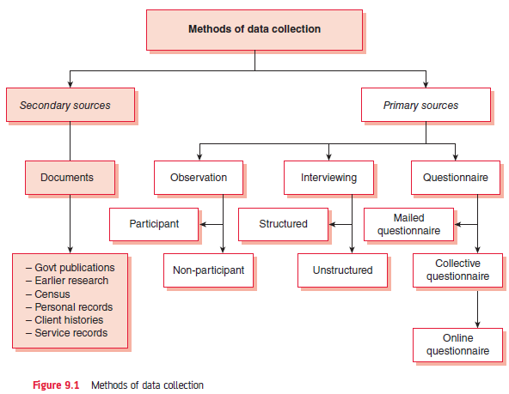
Insert Figure 9.1 Methods of data collection

Slide 6
Major sources of information gathering
Primary data: The researcher undertakes the data collection
Secondary data: The data is already available and can be reanalysed

Slide 7
Observation
Watching and listening to interactions
Participant observation
Non-participant observation
Natural
Controlled
Recording of observations:
Narrative recording
Categorical recording
Recording on electronic devices
Effects that could affect observations:
Hawthorne effect: Participants are aware of the observation and change their behaviour
Elevation effect: Researcher over-uses a particular scale for recording
Halo effect: Researcher bias towards a particular participant

Slide 8
The interview
Questioning people
Unstructured interviews: Freedom in structure, content, wording and order of questions
Structured interviews: Interview schedule predetermines the questions, wording and order

Slide 9
The questionnaire
Written list of questions completed by the respondent
Mail or postal questionnaire (covering letter)
Collective administration
Online questionnaire
Administration in a public place

Slide 10
Choose between interview schedule and questionnaire
Consider the following:
The nature of the investigation
The geographical distribution of the study population
The type of study population

Slide 11
Strengths and weaknesses of questionnaires
Strengths
Weaknesses
Convenience:
Saves time
Inexpensive:
Saves human and financial resources
Offer greater anonymity
No face-to-face action
Likelihood to obtain more accurate information on sensitive questions
Limited application
Low response rate
Self-selecting bias
Lack of opportunity to clarify issues
No opportunity for spontaneous responses
Responses may be influenced by the response to other questions
Others can influence the answers
Responses cannot be supplemented with other information

Slide 12
Advantages and disadvantages of interviews
Advantages
Disadvantages
More appropriate for complex situations
Useful for collecting in-depth information
Information can be supplemented
Questions can be explained
Has a wider application
Time consuming and expensive
Quality of data depends on
Quality of interaction
Quality of interviewer
Could vary when multiple researchers are involved
Possibility of researcher bias

Slide 13
Types of questions
Open-ended questions
Closed questions
Advantages:
Provide in-depth information
Greater variety of information
No investigator bias
Disadvantages
Analysis is more difficult if answers need to be classified
Loss of information if respondents cannot express themselves
Possible interviewer bias
Advantages:
Easy to answer
Easy to analyse due to ready-made categories
Disadvantages:
Information lacks depths and variety
Greater possibility of investigator bias
Answers are selected from a list and may not reflect respondents opinion

Slide 14
Formulating effective questions
Use easy and every day language
Avoid ambiguous questions
Avoid double-barrelled questions
Avoid leading questions
Avoid questions based on assumptions

Slide 15
Constructing a research instrument in quantitative research
Personal and sensitive questions
The order of the questions
Pre-testing a research instrument
Pre-requisites for data collection:
Motivation to share required information
Clear understanding of the questions
Possession of the required information

Slide 16
Methods of data collection in qualitative research
Unstructured interviews
In-depth interviews
Focus group interviews
Narratives
Oral histories
Observation

Slide 17
Collecting data using secondary sources
Government or corporate websites
Earlier research
Personal records
Mass media
Possible problems of secondary data:
Validity and reliability
Personal bias
Availability
Format

